Slide 1

Employee Management System
*****Live Project*****
By
RAJESWARI ARAVA

Slide 2

Index
Introduction
Objective
Software
Java Classes
Conclusion

Slide 3
Introduction
An employee management system is a software, that helps your employees to give their best efforts every day to achieve the goals of your organization.
That makes it easier to store and access the data
when there is a need.

Slide 4

Objective
The objective of “Employee Management System” is designing a scheduling system for a work centre.

Slide 5
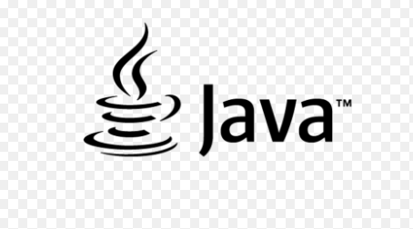

Softwares
1. PROGRAMMING LANGUAGE USED : CORE JAVA
2. IDE USED FOR PROGRAMMING : ECLIPSE IDE

Slide 6

3. FOR TESTING THE FLOW OF PROGRAM : JUNIT 4

Slide 7
.Java class files
@Controller and @Autowired
Repository
@Entity and @Id

Slide 8
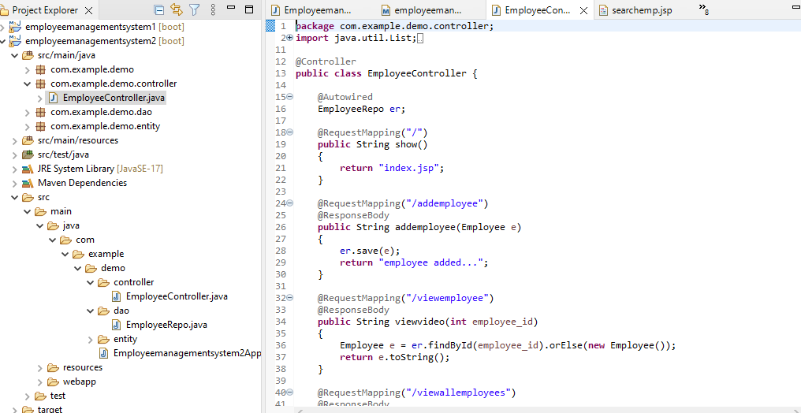
@Controller
In Spring Boot, the controller class is responsible for processing incoming REST API requests, preparing a model, and returning the view to be rendered as a response.
The controller classes in Spring are annotated either by the @Controller or the @RestController annotation.

Slide 9
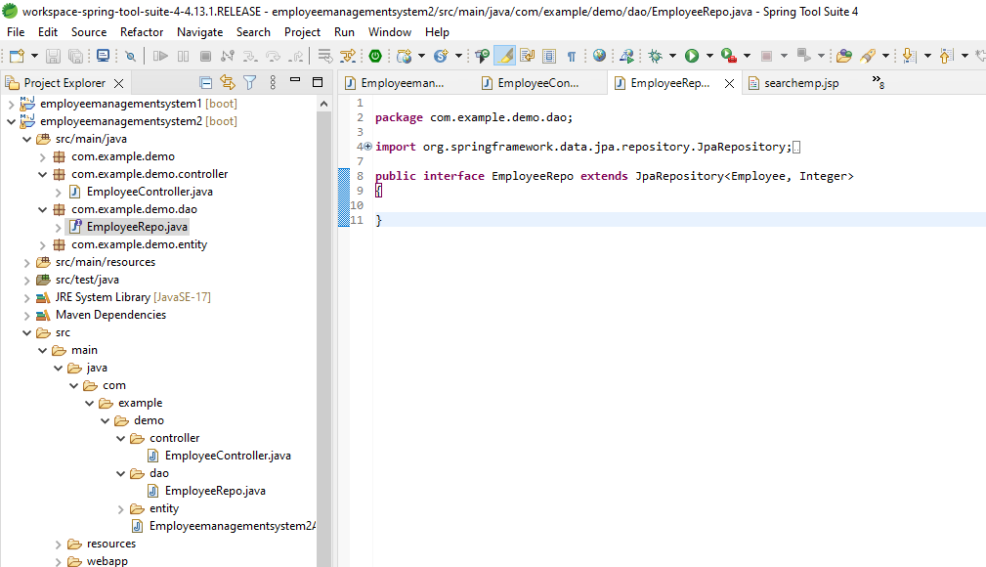
Repository
A repository is a mechanism for encapsulating storage, retrieval, and search behavior which emulates a collection of objects.
JPA handles most of the complexity of JDBC-based database access and object-relational mappings.

Slide 10
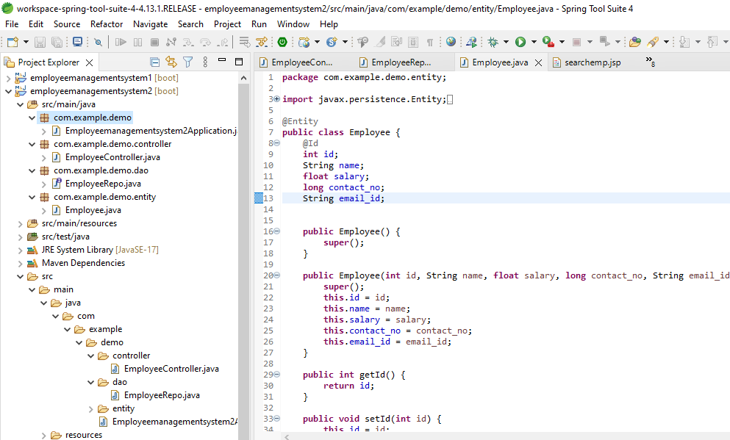
@Entity
The @Entity annotation specifies that the class is an entity and is mapped to a database table.
The @Id annotation specifies the primary key of an entity

Slide 11
Conclusion
In this Employee Management System Project application stores all the employee’s information in a database.
It is an application developed in Java GUI technology and database used is SQLite.
Getters , setters and constructors to are used to display the values.
JUNIT4 is used for testing in eclipse IDE.
It is an easy to use application and has a user-friendly interface.

Slide 12
*********Referral Link********* https://github.com/Rajeswari1219/empproject2.git
Thank You

